Slide 1
Beginner’s Android
APP DEVELOPMENT
Online Class
Extra Material 1

Slide 2
Hi students,
How is your learning after the last class?
Do you manage to create some new apps?

Slide 3

Tip of an Iceberg
What you’ve learned
You should keep learning if you want to create your own apps!
There are more about B4X programming language

Slide 4
What stops you from keep learning?
I am too old to learn!
I don’t have time!
I am not good in English!
I have Technophobia!
Blah blah bla…

Slide 5

Japan’s 82 y0 App Maker
https://youtu.be/nbrnDo0m5hM

Slide 6
[XUI2D]
Example Pack
https://www.b4x.com/android/forum/threads/xui2d-example-pack.96454/

Slide 7
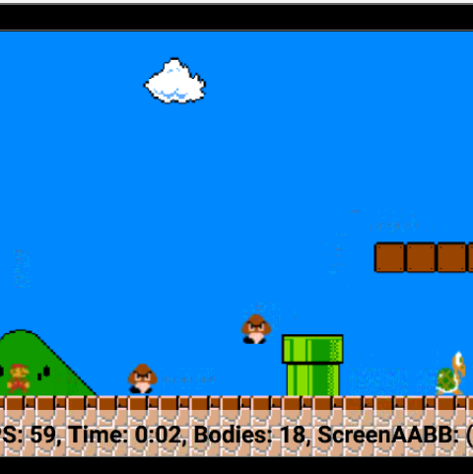
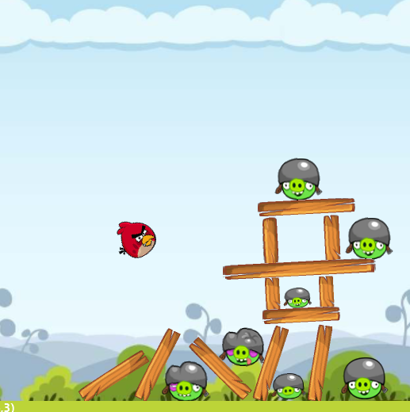
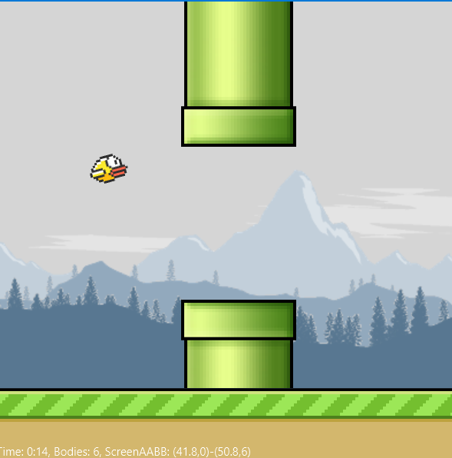
Game Examples
Super Mario
Angry Bird
Clumsy Bird

Slide 8
Create Your Cross Platform Apps Today!
Android (B4A)
iOS (B4i)
Windows, Linux and macOS X Desktops (B4J)

Slide 9
End
Prepared by Aeric Poon
12 May 2021

